Slide 2
Requirements gathering
Design
Implementation
Testing
Deployment
Maintenance

Slide 3
Requirements Analysis
Acceptance Testing
System Design
System Testing
Integration Testing
Architecture Design
Module Design
Unit Testing
Coding

Slide 4
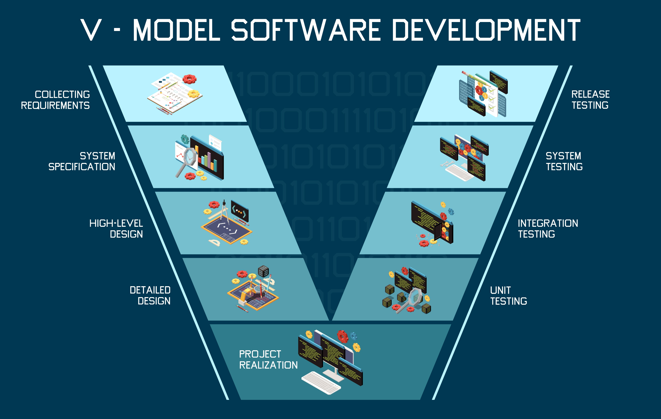
Notes:
(Designed by Freepik)

Slide 5
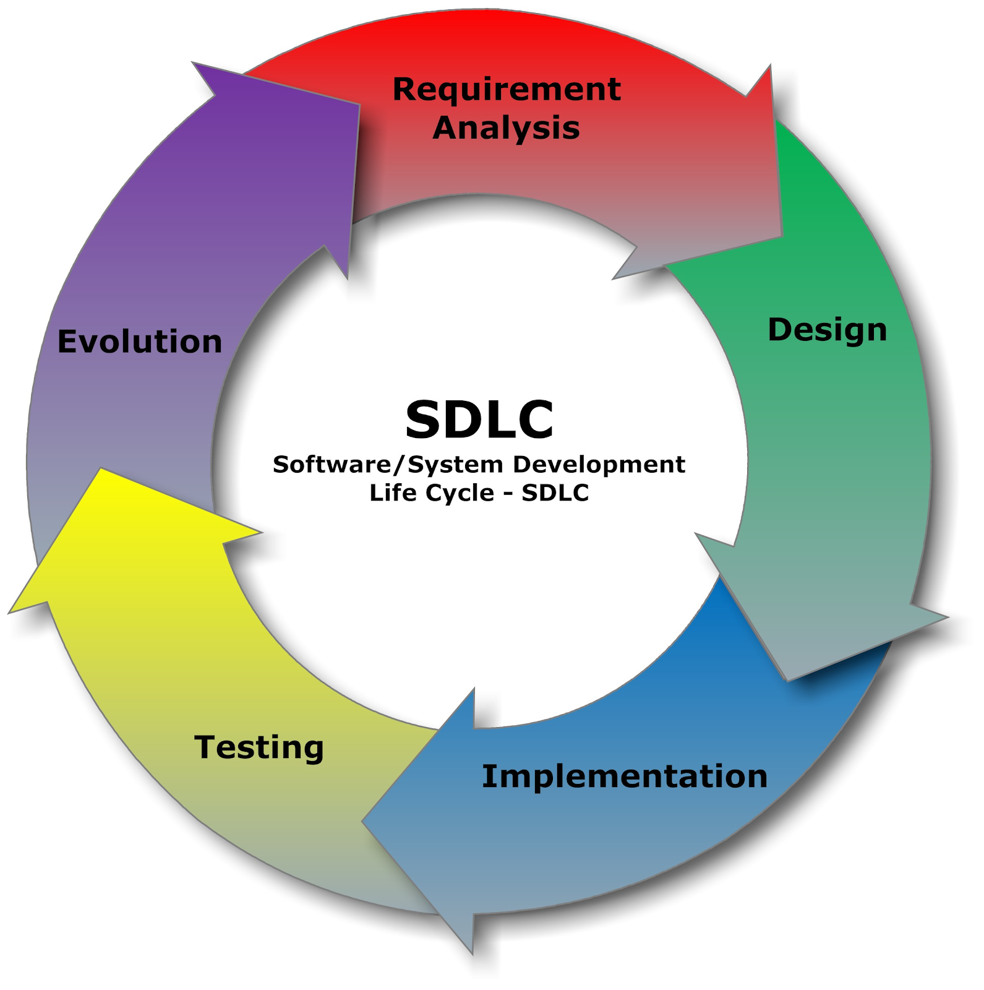
Notes:
(Image from The Carpentries Intermediate Research Software Development)

Slide 6
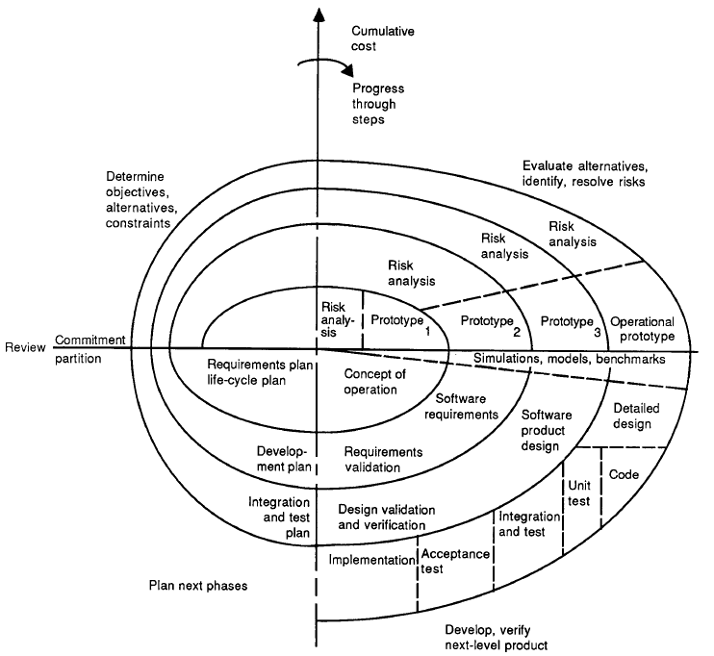
Notes:
(The Spiral Model Diagram from Boehm, 1987)

Slide 7
